Slide 1
ANSYS Tutorial
2D truss analysis

Slide 2
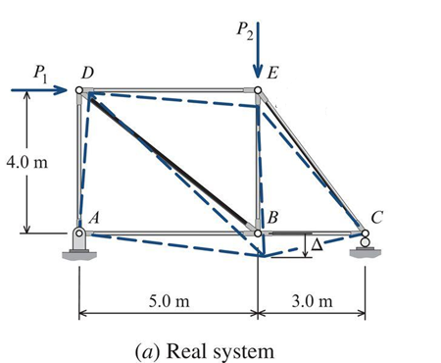
Truss Analysis
Assume E = 70 GPA (ν = 0.3)
Truss member cross-sectional area = 525 mm².
P1 = 10 kN
P2 = 40 kN
We wish to find the deflection of point B (see next slide).
Pin at A and roller at C

Slide 3
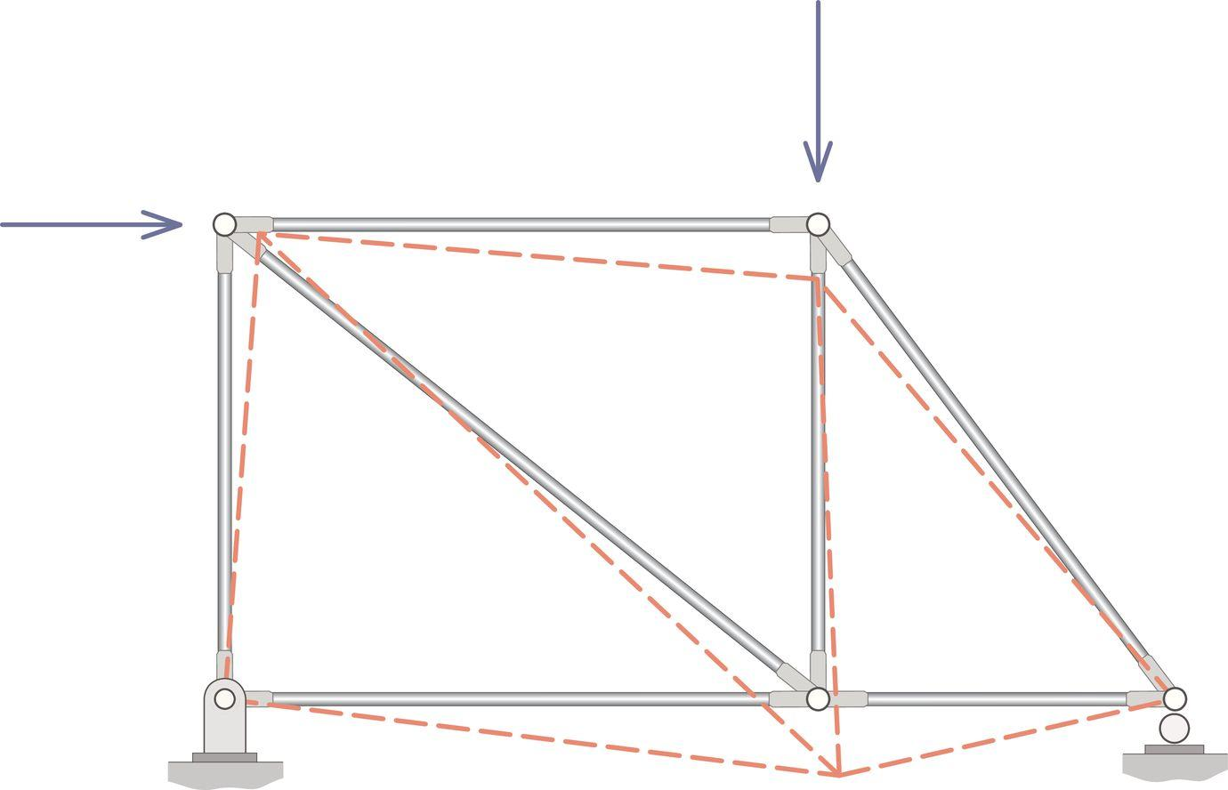
Deflected Truss Shape
We can use energy methods to determine the displacements of nodes (joints) in trusses.
Using the principle of virtual work (PVW), the exact solution of the vertical deflection of point B is 7.68 mm.
We will set up a FEA model and compare the FEA solution to the one predicted by the PVW.
B
7.68 mm

Slide 4
FEA (in a nutshell)
Define material properties
E and nu (linear elastic properties)
Define section properties
Area, moment of inertia, etc.
Define geometry
Nodes and elements (creating the FE ‘mesh’).
Define loads
Forces P1 and P2
Define boundary conditions
Pin and roller
Solve the model
We can place nodes at points A, B, C…
Node ID | x | y
1 | 0 | 0
2 | 5 | 0
3 | 8 | 0
4 | 5 | 4
5 | 0 | 4

Slide 5
How does FEA work? (in a nutshell)
https://www.youtube.com/watch?v=GHjopp47vvQ
One way to understand FEA is that all elements have a stiffness (based on the material properties)
F = Ku (Hooke’s law)
K = spring (or element) stiffness and u is the displacement
When we create FEA mesh, the elements are defined by the nodes and how everything is ‘connected.’
When you study FEA theory in more detail, it possible to assemble a ‘global’ set of equations in matrix form:
{F} = [K]{u}
You prescribe the forces {F}, and the FEA software solves for the displacements {u} at each node.
The [K] matrix is the ‘global stiffness matrix.’

Slide 6
Link to ANSYS Commands
https://www.mm.bme.hu/~gyebro/files/ans_help_v182/ans_cmd/Hlp_C_CmdTOC.html

